Slide 1

cut1
Circular Layout Canvas

Slide 2




cut1
cut2
box3
box1
center_circle
box4
box2
box5

Slide 3
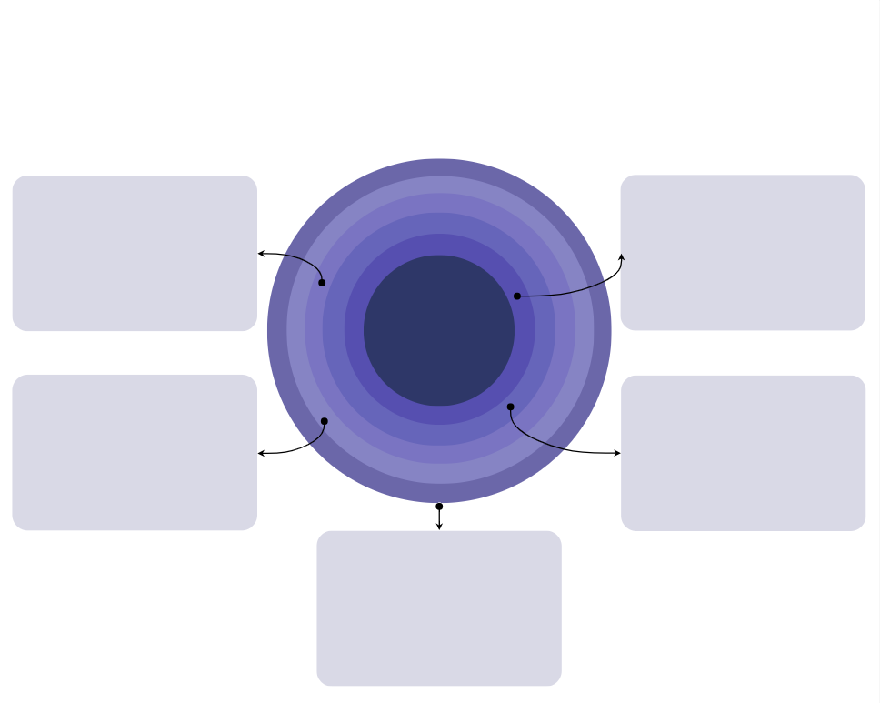
cut1
cut2
box3
box1
center_circle
box4
box2
box5

Slide 4


